Slide 1
Prac 1 & 2
Today is a workday!

Slide 2
If you could have a robot/AI assistant automate any task for you, what would it be? I.e. dishwashing, driving, etc. Get creative
- Dishwasher
- Litter robots
- Lawnmover
-Meal prep
-

Slide 3
Github -> Practicum -> W26 -> Prac 1

Slide 4
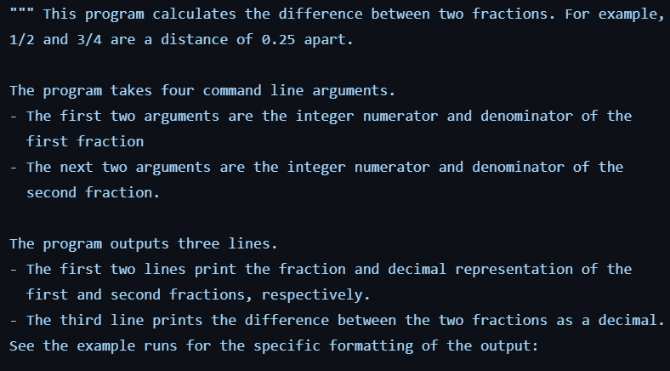
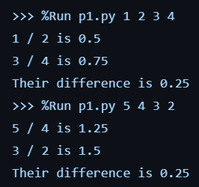
Abs
If

Slide 5
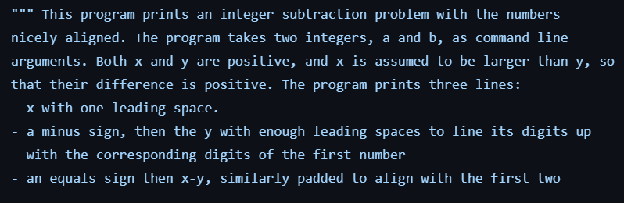
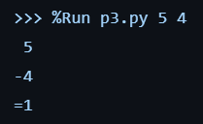
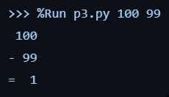
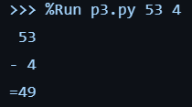

Slide 6
Github -> Practicum -> W26 -> Prac 2 No Answers

Slide 7
Computers, Algorithms, Pseudocode, Function calls
Data Types, Variables
Operators, Expressions and Statements
Keyword Arguments, Binary representation <- we are here
Boolean logic
Conditionals
While loops

Slide 8
What is an algorithm? Give a real-world example of an algorithm.
What Python functions have we used so far and what do they do?
What data types have we used so far, and describe each. How do variables store and use these values?
What is the difference between an operator, an expression, and a statement? Give an example of each.
What is binary? Why do computers use it? Difference between a bit and a byte?
Why is pseudocode useful? Give us a basic pseudocode example of a program that calculates the area of a rectangle.
Notes:
Input and output. Y=2x. tiktok. Optimization
print() input() abs() str() float() int() len()
Str float int, stores whole, stores dec, stores text. Expressions, str print,
Op: math compare division, etc. NOT AND OR. expr: can be evaluated. State: instructions that can be executed
Binary is a system based on 0 and 1. Backbone machine readable. Bit: one digit/part. Byte: 8 bits
Pseudocode useful plain english line for line. Can be translated
Arg1 = len
Arg2 = width
Arg 1 * arg 2
Print result

Slide 9
7 Total Tasks
Work alone today
Let me check you off before you leave
Remember: contains info up until lecture 7

